Slide 1
Image Compression Algorithms

Slide 2
GROUP 12
FATIMA BINTHE MUHAMMAD 2035
UMIT SAHA 2061
MD IMRANUR RAHMAN 2064

Slide 3
What is Image Compression?
Image compression is the process of reducing the file size of digital images by removing redundant or unnecessary data while preserving image quality as much as possible. It is a key technique used to optimize storage, transmission, and processing of images

Slide 4

Compression algorithms
Huffman Coding
Golomb Coding
Arithmetic Coding
LZW Coding
Run-length Coding
Symbol-based Coding
Bit-plane Coding
Block Transform Coding
Predictive Coding
Wavelet Coding
https://github.com/mercersFIRE/DIP-Presentation.git

Slide 5
Arithmetic Coding
Arithmetic Coding is a lossless compression method where an entire message is represented by a single number within the interval [0,1)[0,1), based on symbol probabilities. It offers better compression efficiency than Huffman coding in some cases, especially for data with varying symbol probabilities.
Algorithm:
Initialize Range: Start with [0,1)[0,1).
Process Symbols: Narrow the range based on symbol probabilities.
Encode: Choose a value within the final range.
Decode: Use the encoded value and probabilities to recover the symbols.
Where It Is Used:
Video and Audio Compression (e.g., H.264/HEVC).
File Compression (e.g., Bzip2).

Slide 6
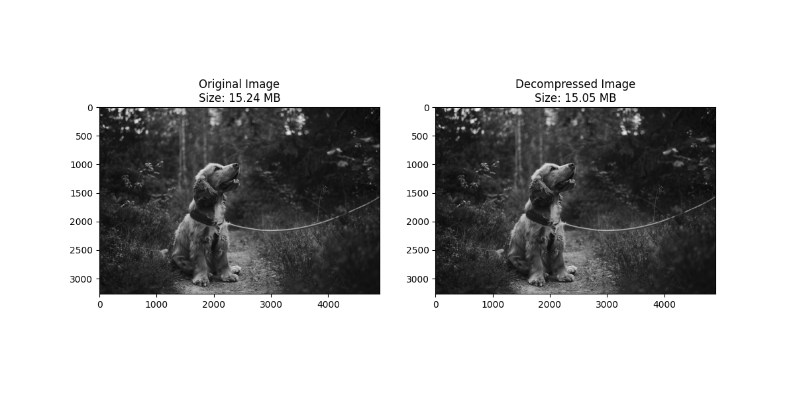
Arithmetic Coding

Slide 7
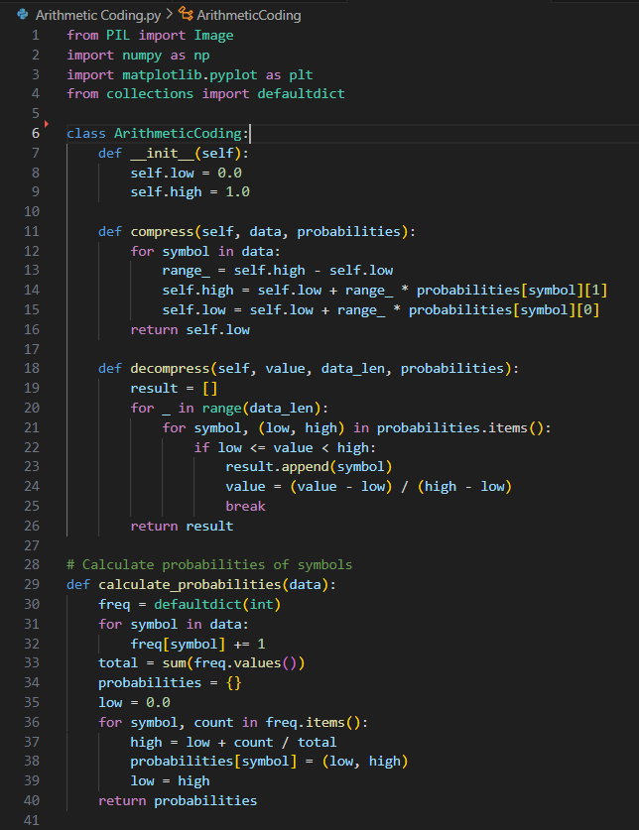
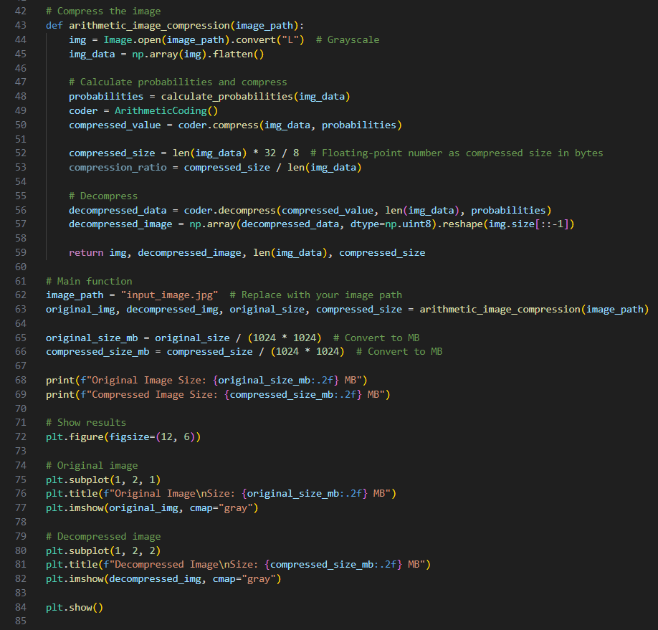
Arithmetic Coding

Slide 8
LZW Coding
LZW (Lempel-Ziv-Welch) coding is a lossless data compression algorithm that builds a dictionary of substrings dynamically as it encodes data. It replaces repeated substrings with shorter codes, achieving compression by removing redundancy.
Algorithm:
Initialize Dictionary: Start with single-character codes.
Encode:
Find the longest substring in the dictionary.
Output its code.
Add the new substring (current + next symbol) to the dictionary.
Decode: Use the dictionary to replace codes with corresponding substrings.
Where It Is Used:
GIF and TIFF image formats.
ZIP file compression.
LZW is the basis for the compression in the Unix compress utility.

Slide 9

LZW Coding

Slide 10
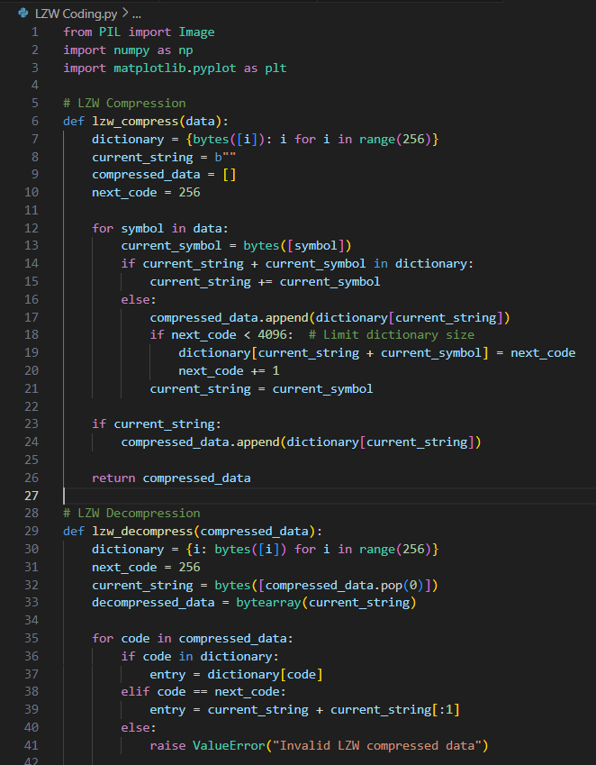
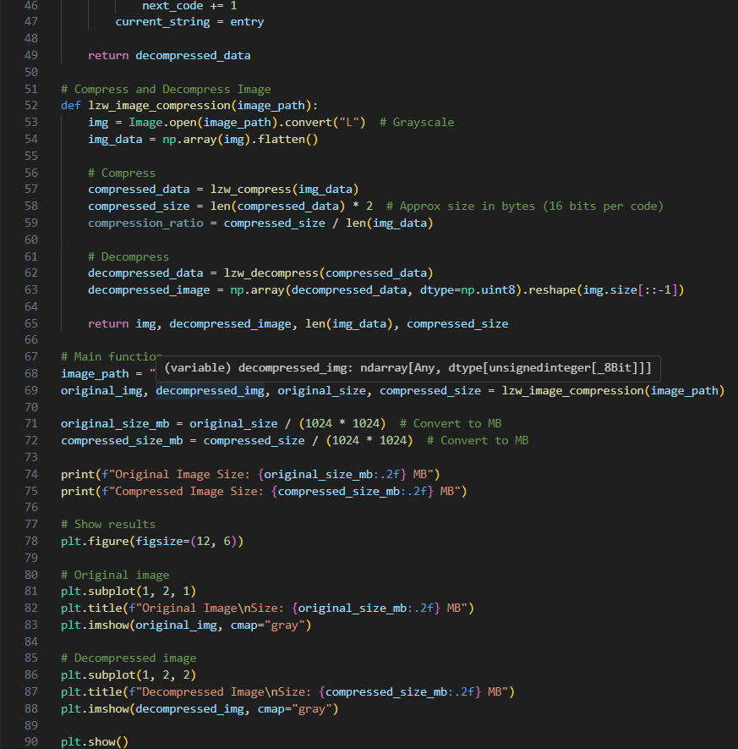
LZW Coding

Slide 11
Thank you

Slide 12
Huffman Coding
Huffman Coding is a lossless compression algorithm that assigns shorter binary codes to more frequent characters and longer codes to less frequent ones.
Algorithm:
Calculate Frequencies: Count how often each character appears.
Build Huffman Tree: Use a priority queue to merge the two least frequent nodes repeatedly into a new parent node.
Generate Codes: Assign binary codes by traversing the tree (left = 0, right = 1).
Encode: Replace each character in the input with its binary code.
Decode: Use the Huffman Tree to reconstruct the original data.
Where It Is Used:
Data Compression: ZIP files and gzip.
Multimedia: JPEG (image compression), MP3, and AAC (audio compression).
Networking: Compressing transmitted data to save bandwidth (e.g., HTTP/2 uses HPACK with Huffman Coding).

Slide 13

Huffman Coding

Slide 14
Golomb Coding
Golomb coding is a lossless compression method particularly suited for encoding integers with a geometric distribution. It splits the input into a quotient and remainder based on a divisor MMM. It is highly efficient in scenarios where smaller numbers are more frequent.
Algorithm:
Choose 𝑀: Select 𝑀, the divisor, based on the data distribution.
Encode: For each integer 𝑁:
Compute Quotient 𝑞=⌊𝑁/𝑀⌋ → Encode 𝑞 in unary.
Compute Remainder 𝑟=𝑁mod 𝑀→ Encode 𝑟 in binary.
Concatenate 𝑞 and 𝑟.
Decode: Read unary for 𝑞, then binary for 𝑟. Reconstruct 𝑁=𝑞×𝑀+𝑟.
Where It Is Used:
Image Compression: PNG and TIFF formats.
Video Coding: H.264/AVC and HEVC use variants of Golomb coding for residual encoding.
Speech Processing: Encoding prediction residuals in audio compression.

Slide 15

Golomb Coding

Slide 16
Run-length Coding
Run-Length Coding (RLC) is a simple form of lossless data compression where consecutive repeated symbols (runs) are replaced by a single symbol and a count of how many times it repeats.
Algorithm:
Initialize: Start with the first symbol.
Encode:
For each symbol, count how many times it repeats consecutively.
Replace the run of symbols with the symbol and its count.
Decode: For each symbol and its count, repeat the symbol for the specified count.
Where It Is Used:
Used in image compression (e.g., BMP and TIFF).
Fax machines and simple data compression.

Slide 17
Run-length Coding

Slide 18
Symbol-based Coding
Symbol-based coding is a technique where each symbol in the input data is replaced by a predefined code, typically of fixed or variable length. The codes can be assigned based on the frequency or importance of the symbols.
Algorithm:
Assign Codes: Assign a unique code to each symbol based on a predefined scheme (fixed or variable length).
Encode: Replace each symbol in the input with its corresponding code.
Decode: Use the predefined scheme to convert the codes back into symbols.
Where It Is Used:
Huffman coding, where the codes are based on symbol frequencies.
Data transmission: Simple encoding schemes in communication systems.

Slide 19

Symbol-based Coding

Slide 20
Bit-Plane Coding
Bit-Plane Coding is a lossless data compression technique that represents an image or data by breaking it down into several bit-planes, each representing a specific bit of the pixel values. Each bit-plane is then encoded separately, which helps in compressing the image more efficiently by exploiting redundancy in the bits.
Algorithm:
Convert to Binary: Convert each pixel value to binary.
Extract Bit-Planes: For each bit position, extract the corresponding bits from all pixels.
Encode: Compress each bit-plane (e.g., using Run-Length Encoding or Huffman coding).
Decode: Reconstruct the original image by combining the bit-planes.
Where It Is Used:
Image Compression (e.g., JPEG).
Image Encryption and Data Hiding.

Slide 21
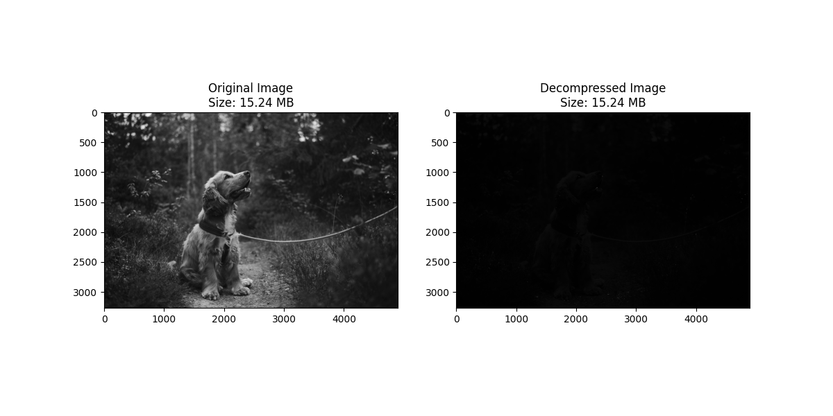
Bit-Plane Coding

Slide 22
Block Transform Coding
Block Transform Coding is a compression technique where the input data (often images) is divided into fixed-size blocks, and a transformation is applied to each block to reduce redundancy. The transformed data is then quantized and encoded for compression.
Algorithm:
Divide into Blocks: Split data (e.g., image) into small blocks (e.g., 8x8).
Apply Transformation: Use a transform (e.g., DCT) on each block.
Quantize: Reduce precision of the transformed coefficients.
Encode: Compress the quantized coefficients (e.g., using RLE or Huffman).
Decode: Reconstruct data by decoding and applying the inverse transform.
Where It Is Used:
JPEG image compression.
Video compression (e.g., MPEG).

Slide 23

Block Transform Coding

Slide 24
Predictive Coding
Predictive Coding is a data compression technique where future values are predicted based on past values, and only the difference (residual) between the predicted and actual values is encoded. This method is efficient when there is correlation between neighboring data points.
Algorithm:
Predict: Predict the next value in the sequence based on previous values (e.g., linear prediction).
Calculate Residual: Compute the residual (difference) between the predicted and actual values.
Encode: Encode the residual using a suitable compression method (e.g., Huffman or Run-Length Encoding).
Decode: Decode the residual and reconstruct the original sequence by adding the residual to the predicted values.
Where It Is Used:
Speech and audio compression (e.g., in codecs like LPC).
Image and video compression (e.g., motion compensation in video coding).

Slide 25
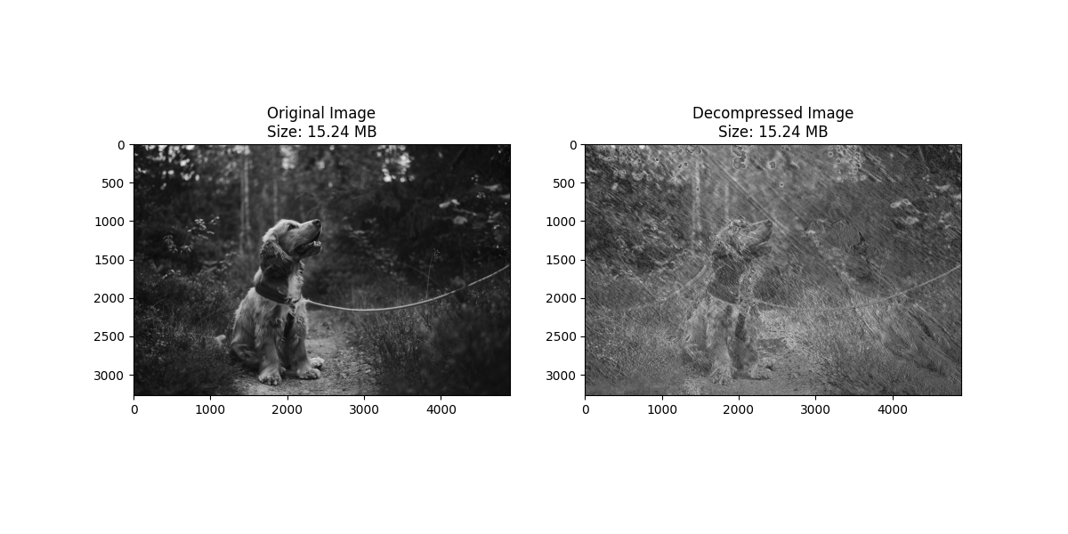
Predictive Coding

Slide 26
Wavelet Coding
Wavelet Coding is a compression technique that applies wavelet transforms to data (e.g., images or signals). Unlike traditional transforms like DCT, wavelets allow multi-resolution analysis, capturing both high and low-frequency components efficiently.
Algorithm:
Apply Wavelet Transform: Decompose data into frequency bands using a wavelet transform (e.g., DWT).
Quantize: Reduce precision of the wavelet coefficients.
Encode: Compress the quantized coefficients (e.g., using Huffman or Arithmetic coding).
Decode: Reconstruct the data by decoding and applying the inverse wavelet transform.
Where It Is Used:
JPEG 2000 image compression.
Medical imaging (e.g., MRI, CT scans).
Video compression (e.g., for high-quality compression)

Slide 27

Wavelet Coding

